Slide 1


DSC Cairo University
Intro
Content
Outro
Time Series
Analysis
HANDS-ON EXPERIENCE
AI
Backend
Cybersecurity
Frontend
Mobile
UI/UX

Slide 2
DSC Cairo University
Intro
Content
Outro
Meet Our Team
Nagham Wael
(Instructor)
Time Series Analysis
1

Slide 3
DSC Cairo University
Intro
Content
Outro
Data Classifying Aspects
in the previous sessions you may have learnt the different aspects we classify data based on, today we will need 2 aspects mostly
Time Series Analysis
2

Slide 4



DSC Cairo University
Intro
Content
Outro
Structure/Shape of the Data
1) Cross-Sectional
2) Time Series
3) Panel/Longitudinal
4) Pooled Cross-Section
Use case
This impacts which models you can apply (e.g., time series models, panel regression, etc.).
Time Series Analysis
3

Slide 5
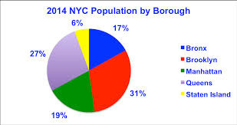
DSC Cairo University
Intro
Content
Outro
cross-sectional
A snapshot at one point in time for many units (e.g., income of 100 people in 2025).
Time Series Analysis
4

Slide 6
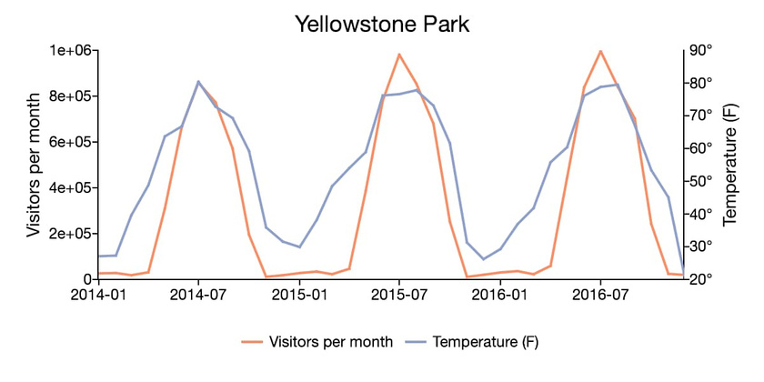
DSC Cairo University
Intro
Content
Outro
Time Series
You track one or more variables for one unit/entity (e.g., one stock, one person) over time
Time Series Analysis
5

Slide 7
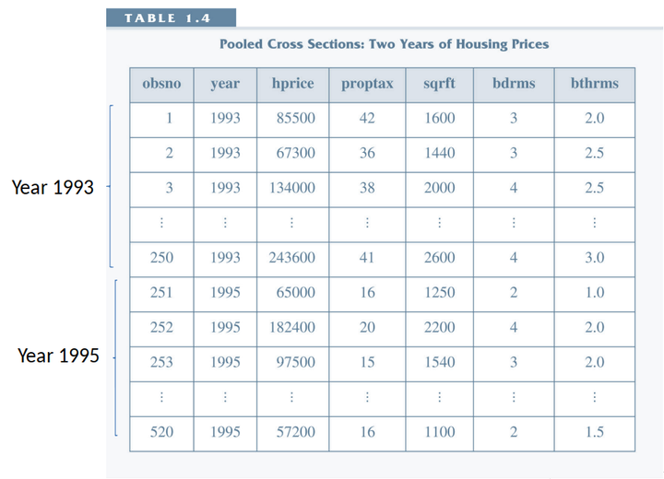
DSC Cairo University
Intro
Content
Outro
Pooled Cross-Section
You observe different entities at different time points (e.g., survey 100 people in 2010, then a different 100 in 2020).
Time Series Analysis
6

Slide 8
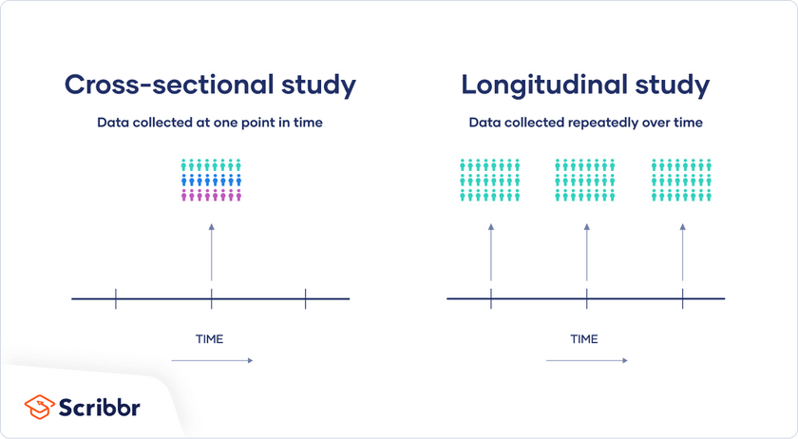
DSC Cairo University
Intro
Content
Outro
Panel/Longitudinal
You observe the same entities over time, often with multiple variables (e.g., tracking the same 100 people from 2010 to 2020).)
Time Series Analysis
7

Slide 9
DSC Cairo University
Intro
Content
Outro
Stationarity
(Time Series Only)
Stationary: data where the statistical properties, like mean and variance, do not change over time
non stationary: data where the statistical properties, such as the mean and variance, are not constant over time
Use case
Stationary data is required for many time series models like ARIMA.
Time Series Analysis
8

Slide 10

DSC Cairo University
Intro
Content
Outro
Read Here
https://ionides.github.io/531w20/03/notes03.pdf
Learn More
Time Series Analysis
9

Slide 11
DSC Cairo University
Intro
Content
Outro
Time Series Patterns
Time series can be composed by variaty of patterns like Trend, Seasonality, Cyclic and Irregular. When we are doing an analysis of time series it is important to know how to detect this patterns, what are the possibles causes and relations, and what are the algorithms able to model and forecast each pattern.
Trend
Season
Cycle
Irregular
Time Series Analysis
10

Slide 12
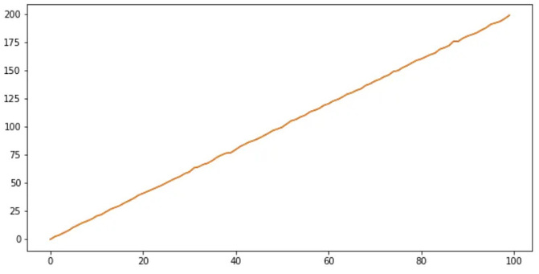
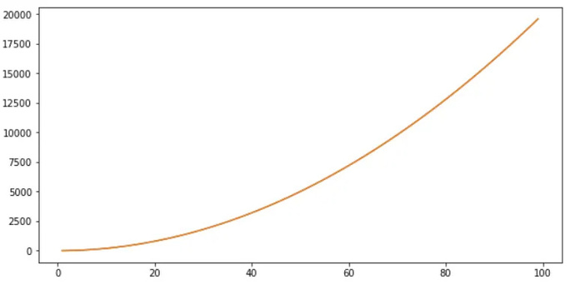
DSC Cairo University
Intro
Content
Outro
Trend
Exists when the values increase or decrease over time
A trend behavior can be linear or nonlinear
linear
nonlinear
Time Series Analysis
11

Slide 13
DSC Cairo University
Intro
Content
Outro
Trend
(cont’d)
A linear trend refers to a consistent upward or downward movement in the data over a period of time.
A linear trend can be used to model the underlying structure of a time series by removing the effects of seasonality and irregular fluctuations.
A linear trend model is a simple but widely used method in time series analysis
linear
Time Series Analysis
12

Slide 14
DSC Cairo University
Intro
Content
Outro
Trend
(cont’d)
A nonlinear trend in time series data refers to a pattern of change that deviates from a straight line. In other words, the rate of change in the data is not constant over time.
Nonlinear trends can take various forms, like an exponential increase or decrease, a polynomial curve, or a combination of different patterns.
Nonlinear trends are commonly observed in time series data with complex underlying structures, such as those with non-constant growth or decay patterns.
nonlinear
Time Series Analysis
13

Slide 15
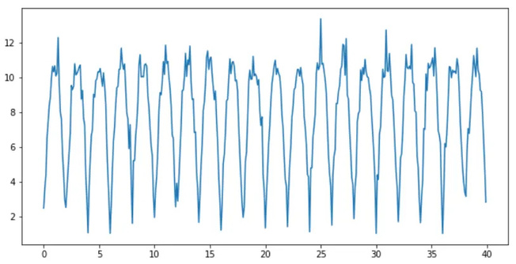
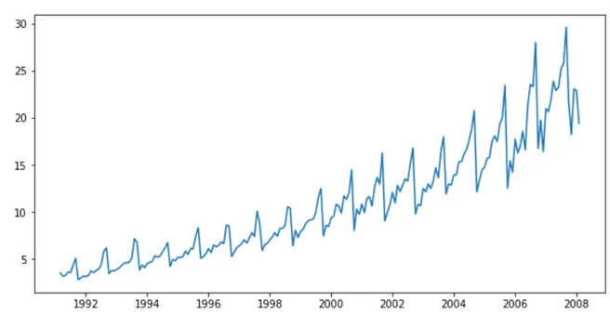
DSC Cairo University
Intro
Content
Outro
Seasonality
A seasonality is a regular pattern in the data that repeat over a fixed time period, for example daily, weekly, monthly, or yearly. We can find two types of seasonality, Additive and Multiplicative.
Additive
Multiplicative
Time Series Analysis
14

Slide 16
DSC Cairo University
Intro
Content
Outro
Seasonality
(cont’d)
pattern where the seasonal fluctuations in the data are consistent in magnitude, regardless of the overall level of the series. In simpler terms, the seasonal effect (e.g., the increase in sales during the holiday season) doesn't change size significantly as the overall sales trend increases or decreases.
Additive
Time Series Analysis
15

Slide 17
DSC Cairo University
Intro
Content
Outro
Seasonality
(cont’d)
the seasonal fluctuations in the data are proportional to the level of the time series. In simpler terms, the "strength" of the seasonal pattern (e.g., how high sales go during the summer) increases or decreases as the overall trend of the data increases or decreases.
Multiplicative
Time Series Analysis
16

Slide 18
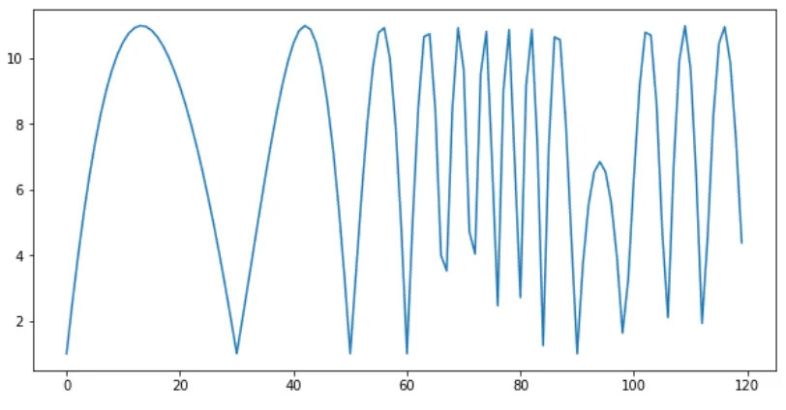
DSC Cairo University
Intro
Content
Outro
Cycle
A cyclic behavior is composed by peaks and valleys that repeat on the time but are not have a fixed frequency.
Time Series Analysis
17

Slide 19
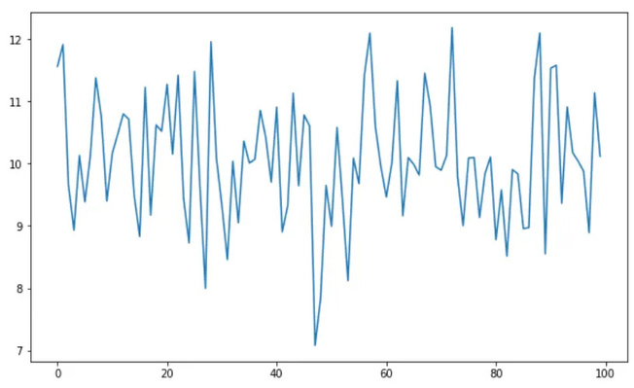
DSC Cairo University
Intro
Content
Outro
Irregular (Residual)
An irregular (also known as residual) pattern is found after we remove the trend and seasonal (when boths exist in the time series) and are fluctuations that can arise from a variety of sources, including measurement errors, random shocks, or unforeseen events that affect the behaviors of the time series.
Time Series Analysis
18

Slide 20

DSC Cairo University
Intro
Content
Outro
Time Series Analysis
a statistical method used to analyze data points collected over a period of time, often at regular intervals
Time series analysis typically requires a large number of data points to ensure consistency and reliability.
An extensive data set ensures you have a representative sample size and that analysis can cut through noisy data.
Time Series Analysis
19

Slide 21
DSC Cairo University
Intro
Content
Outro
Data Type
Time Series Analysis?
Notes
Cross-Sectional
❌
No time dimension
Time Series
✅
Single entity over time
Pooled Cross-Sectional
❌
Entities change over time
Same entities tracked over time
Panel (Longitudinal)
✅ (per entity)
Time Series Analysis
20

Slide 22
DSC Cairo University
Intro
Content
Outro
Time Series Analysis
Now the real question, how to perform time series analysis?
Preprocessing Time Series Data
Time Series Analysis & Decomposition Techniques
Time Series Forecasting
Evaluating Time Series Forecasts
Time Series Analysis
21

Slide 23




Time for Coding !
https://colab.research.google.com/drive/1Nqg7x4tDbw6kt6bIbLKNh_yAq_77IULL?usp=sharingt

Slide 24
DSC Cairo University
Intro
Content
Outro
Thank You
FOR YOUR ATTENTION
Time Series Analysis

